Slide 1
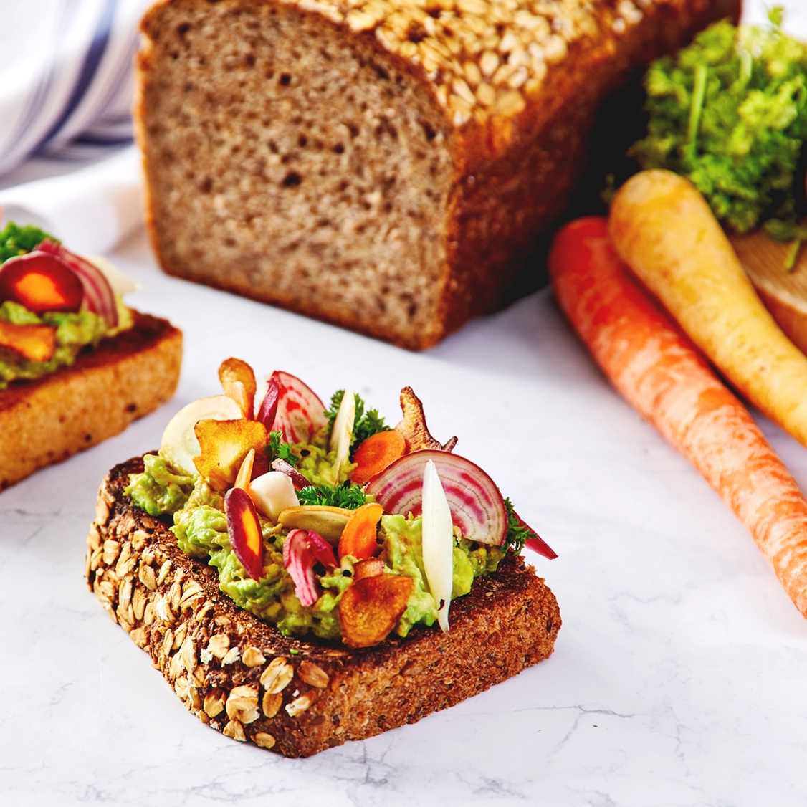


HEALTHY BY DESIGN
CULINARY PRINCIPLES – NUTRITION, HEALTH & WELLNESS
August 2022

Slide 2
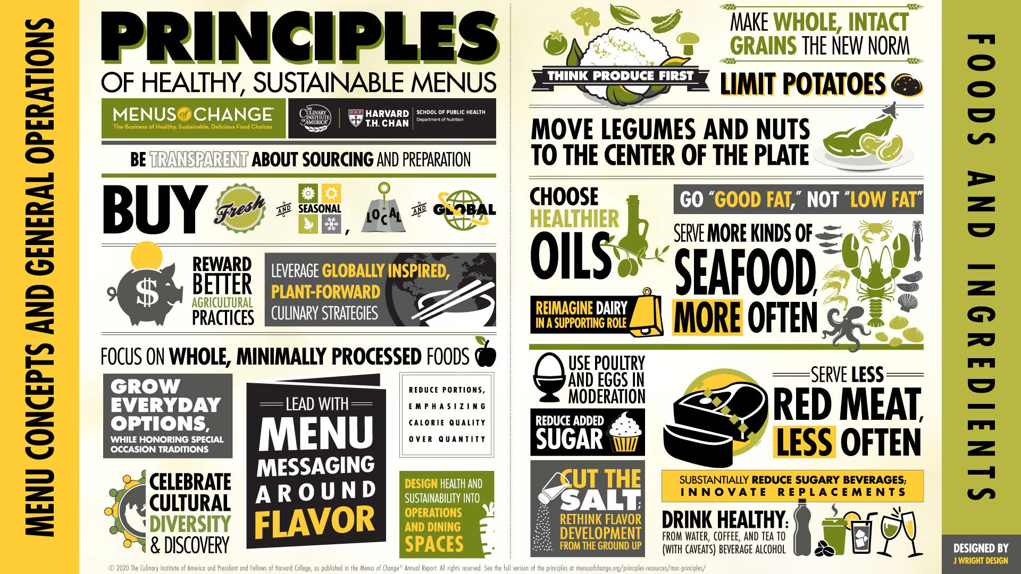

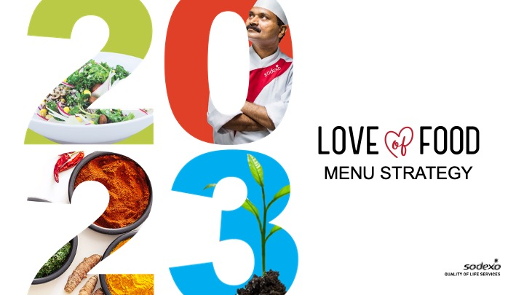
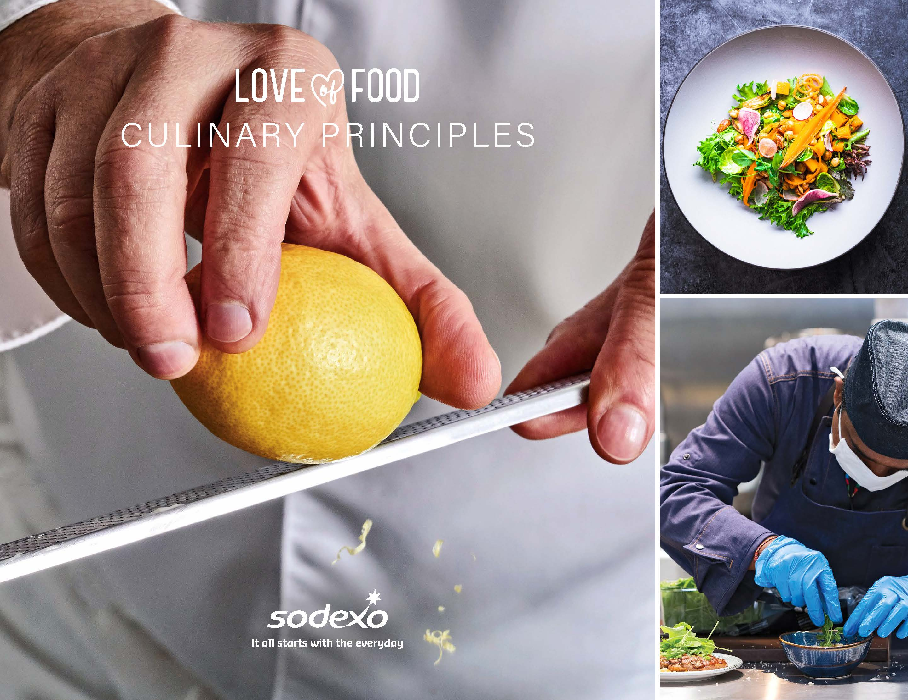

CULINARY PRINCIPLES – NUTRITION, HEALTH & WELLNESS
INTRODUCTION
Sodexo’s Culinary Principles for nutrition, health and wellness provide guidance to ensure nutrition, health and wellness are embedded into our food through key touchpoints, the ingredients we select, and the cooking techniques we use. This allows us to design recipes and menus with NHW at the forefront and to focus on presentation to our guests.
In developing these Culinary Principles, we adopted the Menus of Change principles of healthy and sustainable menus as well as the Eat-Lancet Planetary Health Diet, which provides guidelines to the different ranges food groups that constitute an optimal diet for health and environmental sustainability.
As chefs and culinary professionals, we are well positioned to make healthy and sustainable foods delicious by applying unique insights, skills and creativity to craft next-generation models of innovation in food service and hospitality. This is integral to bringing our guests on a journey of discovery and adoption of the Planetary Health Diet and ensuring it is fully embedded into our Love of Food menu strategy.
MENUS OF CHANGE PRINCIPLES OF HEALTHY, SUSTAINABLE MENUS
EAT- LANCET
FOOD SERVICE BRIEF
EAT- LANCET
REPORT
LOVE OF FOOD MENU STRATEGY
GLOBAL CULINARY PRINCIPLES
WORLD RESOURCES INSTITUTE PLANT-RICH PLAYBOOK
2 SODEXO CULINARY PRINCIPLES

Slide 3
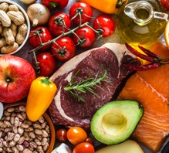
CULINARY PRINCIPLES – NUTRITION, HEALTH & WELLNESS
INGREDIENTS SELECTED WITH CARE
Understand Transparency Around Food Sources, Preparation and Nutrition
Be transparent about the source, methods, and nutrition composition to provide information to guests. Include production methods, sourcing strategies, calorie and nutrient values, farming practices, animal welfare and environmental impacts.
Buy Seasonal and Local Fresh
Incorporate local and seasonal ingredients into menus whenever possible and ensure the focus is always on quality of ingredients.
Promote Agricultural Biodiversity
Explore and experiment with heritage grains and forgotten plants.
Choose Intact Whole Grains, Legumes and Pulses
Offer and highlight slow-metabolizing, whole, and intact grains, such as 100% whole grain bread and brown rice, plus whole grain/higher-based processed products like pasta.
Select the Right Catch of Sustainable Seafood
Use Sodexo’s responsible sourcing guide as part of fish and seafood selection.
Whole and Minimally Processed Options
Are Preferred
We should focus on whole, minimally-processed foods, as they are typically higher in micronutrient value and less likely to contain high levels of added sugars, saturated or trans fats, and sodium.
Short-List Nutritionally Dense Produce and Spices Rich in Phytochemicals and Antioxidants
Lean protein sources like chicken breast, tuna
and salmon.
Qualify Good Fat, Not Just Low Fat
Moderate and even high levels of beneficial fats in the diet, such as non-hydrogenated plant oils, nuts, nut butters, avocados, and fish, are associated with optimal nutrition and healthy weight. When paired with an abundance of vegetables, whole grains, legumes, and nuts, beneficial fats give our diets a baseline of slow-metabolizing, healthy foods that increase satiety.
3 SODEXO CULINARY PRINCIPLES

Slide 4
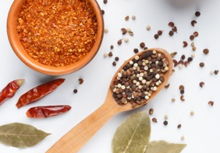
CULINARY PRINCIPLES – NUTRITION, HEALTH & WELLNESS
INGREDIENTS SELECTED WITH CARE
Roasting
Like baking, but typically at higher temperatures, roasting cooks food using an oven's dry heat. You can roast on a baking sheet or in a roasting pan.
For poultry, seafood and meat, place a rack inside the roasting pan so that the fat can drip away. To maintain moisture, cook foods until they reach a safe internal temperature but don't overcook them.
Favour Healthier Oils
A simple way to create healthier menus is to use plant oils and other ingredients that contain unsaturated fats, such as canola, soy, peanut, and olive oils.
Limit Products with Added Sugar and Replace with Natural Alternatives
Select processed foods with little or no added sugar and favor healthy oils over sugar in products such as salad dressings. Serve smaller dessert portions with fruit. In recipes, substitute sugar with whole, cut and dried fruit.
Notable Additions
Reduce added salt by rethinking how you develop flavors. You can reduce reliance on salt for flavor and use other seasoning opportunities by sourcing the best quality, highest-flavor produce, incorporating spices, herbs, citrus, and other aromatics and employing healthy sauces, seasonings, and other flavor-building techniques from around the world.
Factor digestive health benefits into dish development and promote positive gut health by using ingredients that contain minerals, vitamins, herbs, fibre, amino acids, antioxidants, prebiotics and probiotics.
4 SODEXO CULINARY PRINCIPLES

Slide 5
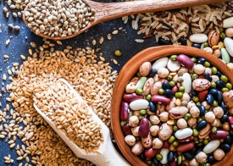
CULINARY PRINCIPLES – NUTRITION, HEALTH & WELLNESS
MENU DESIGN
  Offer A Diverse Selection Of Foods
  It’s important that every dish is visually appealing, and color plays a key role. Additionally, the vitamins and antioxidants needed for nutrient balance and gut health occur in green, red, yellow, blue, white colours.
  Serve More Sustainable Seafood More Often
  Seafood is important to provide a balanced diet with enhanced nutritional benefits. Serving an array of sustainable seafood aligns with our Love of Food menu strategy to increase sustainable seafood in our central menus.
  Reimagine Dairy In a Supporting Role
  Embrace the innovation happening in plant-based dairy and minimize the use of milk and dairy. Use cheese in smaller amounts and minimize the use of butter. Yogurt (without added sugar) is a good choice, as its consumption is associated with healthy weight.
  Menu Eggs and Poultry In Moderation
  Use global and local programs to support plant-based alternatives. Menu chicken and other poultry in moderation, as it is a healthier protein with a far lower environmental footprint than red meat. Avoid or minimize the use of processed poultry products, which are high in sodium, often as a result of sodium pumps and brining. Offer eggs in moderation, as the recommended consumption is an average of one per day.
  Serve Less Red Meat, Less Often
  Rethink how you use meat and feature it as a support to healthier plant-based choices. Experiment with meat as a condiment, limiting processed meats and focus on alternative sources of protein.
  Feature Whole Grains, Legumes, Vegetables and Fruits
  Your menu design should be plant-forward centric and allow whole grains, legumes, vegetables and fruits be the stars.
5 SODEXO CULINARY PRINCIPLES

Slide 6
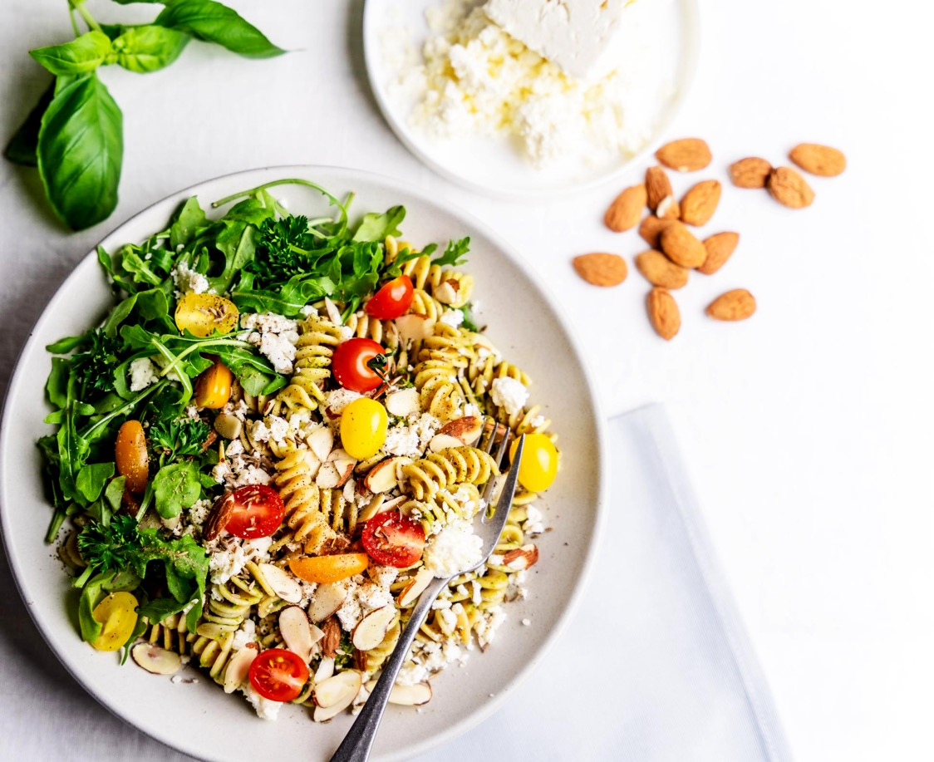
CULINARY PRINCIPLES – NUTRITION, HEALTH & WELLNESS
MENU DESIGN
  Offer Predominantly Plant-Based Ethnic Cuisines Ensure all dishes are aligned to consumer insights and that they respect the authentic flavors and techniques.
  Increase Allergen-friendly And Diet-Specific Options
  There is a growing consumer and market demand, so be sure to offer several choices.
  Ensure Functional Options Are Available Across All Dayparts
  Although some indulgences may be high in nutrients like carbohydrates and fat, they do bring comfort and recovery benefits to our guests. Just be sure to offer calorie quality over quantity.
  Build Menus Aligned To Sodexo’s Love Of Food Menu Strategy Targets
  Incorporate dishes that support a healthy and nutritious diet and align to Sodexo’s menu strategy and targets around nutrition, health and wellness, responsible sourcing, sustainable seafood and plant-based/plant forward offerings.
6 SODEXO CULINARY PRINCIPLES

Slide 7
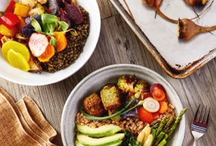
CULINARY PRINCIPLES – NUTRITION, HEALTH & WELLNESS
DISH DESIGN
  Quantify Appropriate Portion Sizes Guided By Local Health Recommendations
  Healthy is defined by an individual’s consumption requirement against output. For a sedentary person working in an admin role, foods like fried chicken that are high-calorie in fat and sugar) is not the best choice for lunch. But when served in a reduced size, it’s good to pair with a cold grain salad. Sometimes a little indulgence satisfies the mind and the body. One of the biggest steps we can take to reverse obesity trends and its chronic disease impact is by moderating portion size . Reducing portions back down from oversized to nutritionally appropriate is not only the right thing to do for nutrition, health and wellness, it also supports food cost savings and guest satisfaction. Put your guests’ needs first by being flexible with how each you design each dish.
  Understand Complete Protein Combinations That Are Plant-based
  Most plant-based foods are single, incomplete proteins. Nearly all are low in one or more of the essential amino acids one’s body needs to thrive. However, being incomplete doesn't mean that plant-based foods are low in protein. A combination of different protein sources will ultimately ensure one gets an ample supply of all the amino acids needed every day. Example combinations are:
    Grains and legumes
    Rice and beans
    Brazilian-style black
    beans with rice
    Mexican burrito
    Pasta with peas
    Spaghetti with pea pesto
    Whole wheat bread and a nut spread
    Peanut butter sandwich
    Nuts or seeds with legumes
    Chickpeas and tahini
    Hummus
    Lentils and almonds
  Some single instances are a complete protein, such as soy (tempeh, tofu or edamame), chia, quinoa, hemp seeds and amaranth.
7 SODEXO CULINARY PRINCIPLES

Slide 8

CULINARY PRINCIPLES – NUTRITION, HEALTH & WELLNESS
DISH DESIGN
  Lead with Impactful Dish Messaging
  The best way to convince people to make a particular food choice in a matter of seconds is to make an emotional connection. Use a NOUN (such as the country/city) or an ACTIONABLE word (rustic, earthy, smokey, wood-like, sawdust, burnt, etc.) will trigger a guest’s memory and desire. A story is a verb, so highlight the main points of the food story with a impactful words and phrases. Matching the dish’s story to a guest need, such as wanting a healthy lifestyle is very effective.
  Move Plants to the Center of the Plate
  Promote plant-forward/plant-based dishes to be the majority of the plate. Produce is naturally full of flavor – sweet, salty, sour, bitter and umami. There is an abundance of ingredients to broaden our recipes’ primary flavor profiles.
  Flip All-Time Favorites to Plant-based Protein
  Psychologically, people are mostly adverse to change. It’s important to make the unfamiliar familiar so they consider trying new things. Adapting their favorites, especially comfort dishes, can make them feel adventurous. Be sure to prioritize plant-forward and plant-based dishes according to Sodexo’s Love of Food menu strategy and targets.
  Leverage Ingredients’ Natural Sweetness
  You can use less sugar, salt or other flavorings by using certain cooking methods to boost the flavor of what’s already in your ingredients.
  Write Concise and Easy-to-Read Recipes
  Your kitchen service will be more efficient when key information is clearly presented. Use fewer and simpler words, break instructions into paragraphs, and highlight or capitalize words and phrases.
  Establish Quality Standards for Back
  of House Staff
  Setting defined quality criteria allows chefs and cooks to understand and control the appearance, aroma, taste, texture, and consistency of every dish in the central recipe bank.
8 SODEXO CULINARY PRINCIPLES

Slide 9

CULINARY PRINCIPLES – NUTRITION, HEALTH & WELLNESS
COOKING TECHNIQUES
  Employ Healthier Cooking Methods That Maximize Nutrient Retention
  Steaming, shallow poaching, blanching, broiling/grilling/roasting, shallow-frying, stir-frying, microwaving
  Understand How Flavors Complement One Another and Make Adjustments
  Sometimes, there is a regional style/flavor preference for a national/ethnic signature dish. Tune the flavor indicators and use another cooking/seasoning/cutting methods to cater to health requirements and guest palatability.
  Use Smart Cooking Technology to Operate with Precision
  Low heat cookery, such as sous vide, preserves nutrients, cooked yield, and textures
  Tenderize tough cuts and retain more nutrients in shorter cooking duration by pressure cooking
  Steaming provides even heat distribution.
  A combination of dry and moist heat regenerates pre-cooked foods to optimal serving conditions
  Use shorter pre-heating durations to bake off breads and pizzas
  Dehydrate at controllable settings for temperature, humidity, and fan circulation speed
  Use an oven temperature probe to assist in determining doneness
  Consider using robotic arms to serve coffee, tea, lattes, wok-fried dishes, eggs, pancakes at a dedicated live counter
9 SODEXO CULINARY PRINCIPLES

Slide 10

CULINARY PRINCIPLES – NUTRITION, HEALTH & WELLNESS
COOKING TECHNIQUES
  Taste As You Cook
  Prevent under or over-seasoning/cooking by being aware as you prepare and cook food. Taste each dish component or end-product before serving them to guests.
  Remove Excess Fat, Sinew and Tough Fibers
  Preparing ingredients leads to a better raw product and higher quality when cooked, which substantiates the value-based pricing of dishes based on less popular or secondary cuts of meat.
  Skim Off Impurities While Cooking
  By skimming scum and fat in stocks, broth, and soups, unpalatable factors that contribute to gamey smells and a cloudy appearance are eliminated. When skimmed, the base is unpolluted and clean for the next level of seasoning and flavor fortification, such as using a clean vegetable stock to create a green velouté.
  Intensify Flavors Using Alternate Methods
  Aging, curing, wet marinade, reduction, and compression
  Thickening stocks and sauces to glazes
  Emulsify broths through boiling to reduce or fortify with roux/fat
  Heighten existing sweetness with vacuum compression
  Pickle foods to create layered complexity
  Cure meat and seafood to create a different form for versatility.
  Use Salt with Care and Purpose
  Salt is necessary evil. We require sodium to regulate our bodily functions (retaining water composition and pH). In food, salt is used to increase gluten formation in bread making. A touch of salt and lemon juice brightens up the best raw oysters. Brining chicken, turkey, or brisket for corned beef, barbeques or roast is a controlled seasoning method (e.g 3% brine) and helps elevate natural protein flavor and retain moisture (natural jus).
10 SODEXO CULINARY PRINCIPLES

Slide 11

CULINARY PRINCIPLES – NUTRITION, HEALTH & WELLNESS
PRESENTATION & PLACEMENT
At Sodexo, food quality and presentation are critical. This is exceptionally true with healthy dishes. Ensuring healthy food is visually appealing is an important way to increase uptake. Guests eat with their eyes, and we only get one chance to make a great impression. Please review the Global Culinary Principles for standard information on proper presentation.
Place Healthier Options Within Reach - and Others Further Away
By making healthy options accessible and unhealthy products less available, we can create a pause point that brings our guests greater awareness about their choices. Because so much of what we do is done by habit, it may make people change their behavior - or at least consider it. The way food is presented and physically positioned has a massive impact on what people choose and eat. A few simple tweaks can nudge diners into making healthier choices.
Make the Unconscious Conscious
Keep healthy choices in the front of guests’ minds through messaging and communication. Be sure to leverage your menu structure to evolve the presentation and avoid repetition, as rearranging products and menus might be all that’s needed to break habits and encourage people to try a different, healthier choice.
Perfectly Portioned
Ensure your staff is fully trained to understand the impact of incorrect portion sizes. Where possible, use serviceware to identify the correct individual portion. Be sure to match portion sizes to plates/packaging, while providing a balanced arrangement of components. Include alternative portion sizes for popular dishes. We put our guests first, and should offer flexible portions to suit their needs.
11 SODEXO CULINARY PRINCIPLES

Slide 12
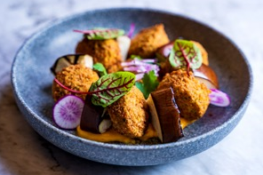


CULINARY PRINCIPLES – NUTRITION, HEALTH & WELLNESS
PRESENTATION & PLACEMENT
Create Height and Volume:
This suggests freshness and abundance, creating interest and excitement.
Conceptualize Spatial Designs That Flatter Food Quality
For example, fanning a steak that is sliced on a bias, therefore making the meat grain visible.
Use Edible Garnish and Vessels Purposefully
You can reflect a connection with nature and seasons, using the Japanese Kaiseki plating
Leverage the Behavioural Change Studies From the World Resources Institute
PLACEMENT
PRESENTATION
PROMOTION
PEOPLE
12 SODEXO CULINARY PRINCIPLES

Slide 13
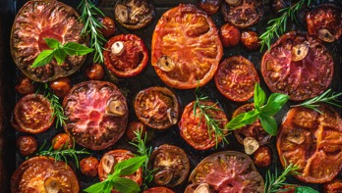
CULINARY PRINCIPLES – NUTRITION, HEALTH & WELLNESS
GLOSSARY
These healthy-cooking methods best capture a food’s flavor and retain its nutrients without adding excessive amounts of fat or salt.
Baking
Besides breads and desserts, you can bake seafood, poultry, lean meat, vegetables and fruits. Place food in a pan or dish, covered or uncovered. Baking generally doesn't require adding fat.
Braising
When braising, the ingredient is first browned in a pan on the stovetop, and then partially covered with a small quantity of liquid (such as water or broth) and slowly cooked. In some recipes, the cooking liquid is used afterward to form a flavorful, nutrient-rich sauce.
Broiling and Grilling
Broiling and grilling expose food to direct heat, allowing fat to drip away from the food.
To grill outdoors, place the food on a grill rack above a bed of charcoal embers or gas-heated rocks. If you have an indoor grill, follow the manufacturer's directions. For smaller items, such as chopped vegetables, use foil or a long-handled grill basket to prevent pieces from slipping through the rack.
To broil, place food on a broiler rack below a heat element.
Poaching
Gently simmer ingredients in water or a flavorful liquid (such as broth or wine) until they're cooked through and tender. The food retains its shape during cooking. For stovetop poaching, choose a covered pan that best fits the size and shape of the food so that you can use a minimal amount of liquid.
Red Meat
All red meat must adhere to Sodexo’s responsible sourcing and animal welfare guidance. Reduce red meat consumption on our menus to no more than 10%.
13 SODEXO CULINARY PRINCIPLES

Slide 14
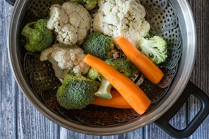
CULINARY PRINCIPLES – NUTRITION, HEALTH & WELLNESS
GLOSSARY
Roasting
Like baking, but typically at higher temperatures, roasting cooks food using an oven's dry heat. You can roast on a baking sheet or in a roasting pan.
For poultry, seafood and meat, place a rack inside the roasting pan so that the fat can drip away. To maintain moisture, cook foods until they reach a safe internal temperature but don't overcook them.
Sautéing
Sautéing cooks small or thin pieces of food quickly. Using a quality non-stick pan eliminates the need to use fat. Depending on the recipe, low-sodium broth, cooking spray or water may be used in place of oil.
Searing
Searing browns the surface of food at a high temperature, locking in flavor and adding a crusty texture to meats and other proteins. Heat a pan on high heat and use a small amount of oil for a golden crust. Finish cooking with another method such as braising or roasting.
Steaming
One of the simplest cooking techniques is steaming food in a perforated basket suspended above simmering liquid. Use a flavorful liquid or add seasonings to the water to flavor the food as it cooks.
Stir-frying
Stir-frying cooks small, uniform-sized pieces of food as they're rapidly stirred in a wok or large non-stick frying pan. Use only a small amount of oil or cooking spray.
14 SODEXO CULINARY PRINCIPLES

Slide 15
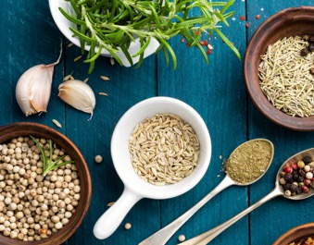
CULINARY PRINCIPLES – NUTRITION, HEALTH & WELLNESS
FLAVOR ENHANCEMENT
Creating meals with herbs, spices and other natural flavorings is one of the best ways to add color, taste and aroma to foods without adding salt or fat.
Herbs
Culinary herbs are leafy plants that add flavor and color to all types of meals. They are also rich in health-protective Phyto-oestrogens. In many cases, herbs can replace the flavor of salt and oil.
Remember:
  Herbs are delicately flavored, so add them to your cooking in the last few minutes.
  Dried herbs are more strongly flavored than fresh. As a rule, one teaspoon of dried herbs equals four teaspoons of fresh.
  In addition to meat dishes, herbs can be added to soups, breads, mustards, salad dressings, vinegars, desserts and drinks.
  Coriander, ginger, garlic, chilli and lemongrass are especially complimentary herbs in vegetable-based stir-fry recipes.
  Choose fresh herbs that look bright and aren't wilted, adding them toward the end of cooking.
  Add pinches of dried herbs in the earlier stages of cooking. Avoid pre-packaged seasoning mixes, which often contain a lot of salt.
15 SODEXO CULINARY PRINCIPLES

Slide 16

CULINARY PRINCIPLES – NUTRITION, HEALTH & WELLNESS
FLAVOR ENHANCEMENT
Dried Mustard
Used sparingly, dried mustard adds a zesty flavor while cooking.
Vinegar or Citrus Juices
Vinegar is great on vegetables, and citrus works well on fruit such as melons. Add them at the last moment.
Marinades
Try a low-fat marinade for foods that are broiled, grilled or roasted. Make a marinade using 1 part oil to 2 parts vinegar or citrus juice, adding herbs and spices as desired.
Fresh Hot Peppers
Remove the membranes and seeds first, and then finely chop the peppers. A small amount goes a long way.
Dried Vegetables and Fruits
Some vegetables and fruits (such as mushrooms, tomatoes, chilies, cherries, cranberries and currants) have a more intense flavor when dried than when fresh. Add them when you want a burst of flavor.
Seaweed
Natural seaweed has been used to add flavor into dishes for centuries. Not only is it vitamin-packed, but it is also an essential way to create the Umami taste profile.
16 SODEXO CULINARY PRINCIPLES

Slide 17
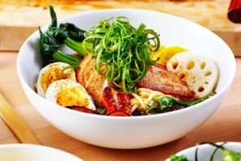
CULINARY PRINCIPLES – NUTRITION, HEALTH & WELLNESS
LOW-FAT COOKING GUIDANCE
Try cooking sprays or apply just a small amount of oil with a pastry brush.
Instead of oil, cook in liquids such as stock, wine, lemon juice, fruit juice, vinegar or water.
Instead of cream in sauces or soups, use low-fat yogurt, low-fat milk, evaporated skim milk or corn-starch.
When browning vegetables, put them in a hot pan then spray with oil, rather than adding the oil first to the pan. This reduces the amount of oil that vegetables absorb during cooking.
An alternative to browning vegetables by pan-frying is to cook them first in the microwave, then crisp them under the grill for a minute or two.
Use pesto, salsas, chutneys and vinegars in place of sour creams, butter and creamy sauces.
17 SODEXO CULINARY PRINCIPLES

Slide 18
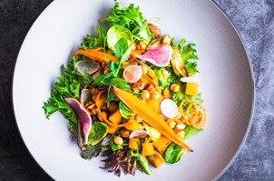
CULINARY PRINCIPLES – NUTRITION, HEALTH & WELLNESS
RETAINING THE NUTRIENTS
Water-soluble vitamins are delicate and easily destroyed during preparation and cooking. To minimise nutrient losses:
Scrub vegetables rather than peel them, as many nutrients are found close to the skin.
Instead of boiling vegetables, microwave or steam them.
If you do boil vegetables, use a small amount of water and do not overboil them.
Include more stir-fry recipes, as stir-fried vegetables are cooked quickly to retain their crunch and associated nutrients.
18 SODEXO CULINARY PRINCIPLES

