Slide 1
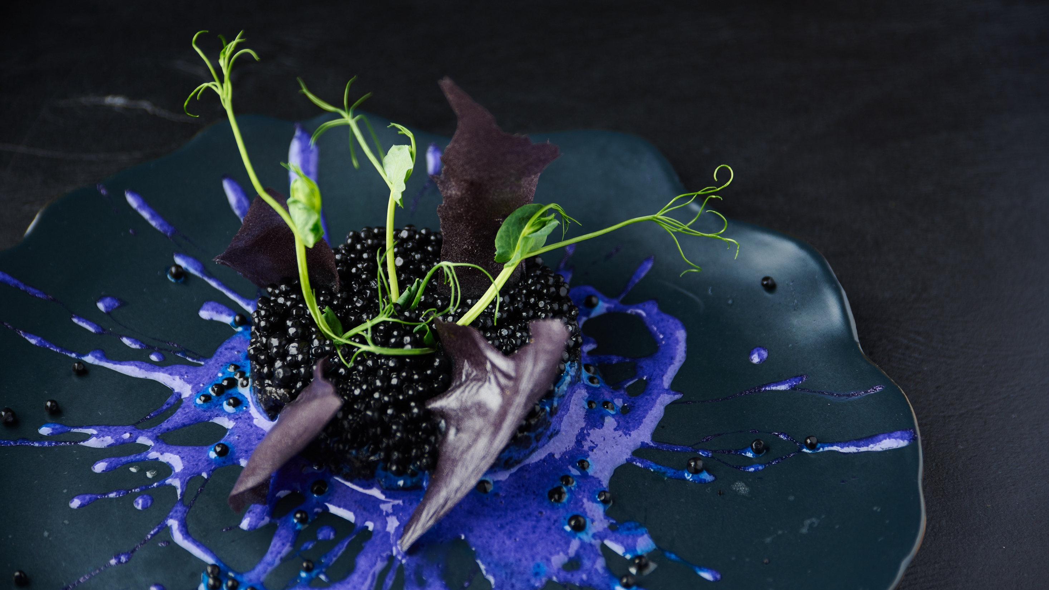
PHOTOGRAPHY TIPS

Slide 2
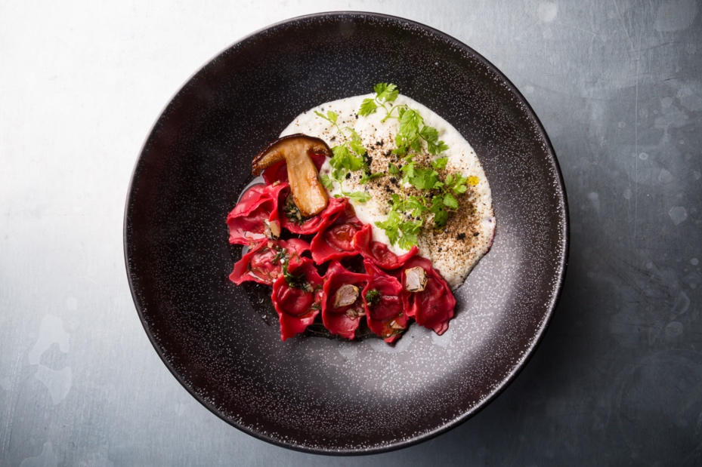
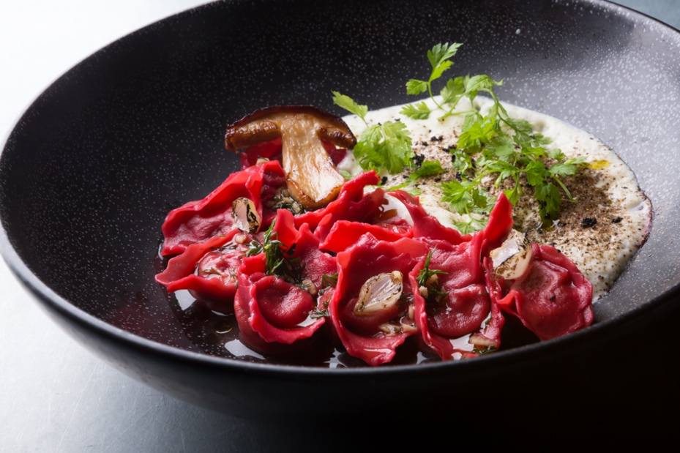
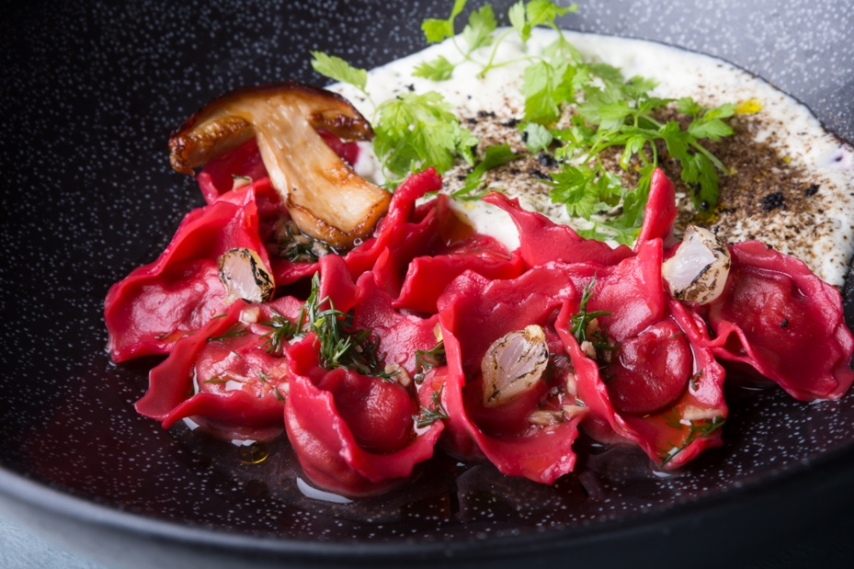
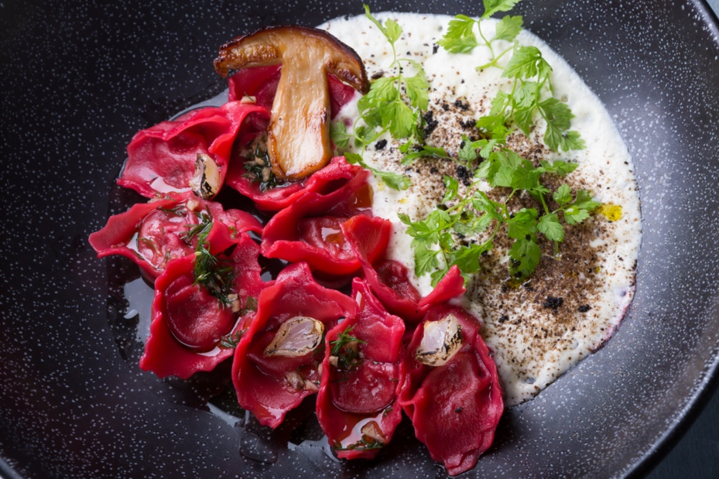
MORE IS BETTER​
Especially when you’re taking photos, that is!
As you take photographs, continuously change your angle and move around your subject. You may create a better image when you challenge yourself to think outside the box.
Digital photography allows you to take multiple versions of the same subject and instantly assess the success of your images as you work. With each click, you can make adjustments to compose a better image.
​​
Have fun, challenge yourself and be creative.​

Slide 3
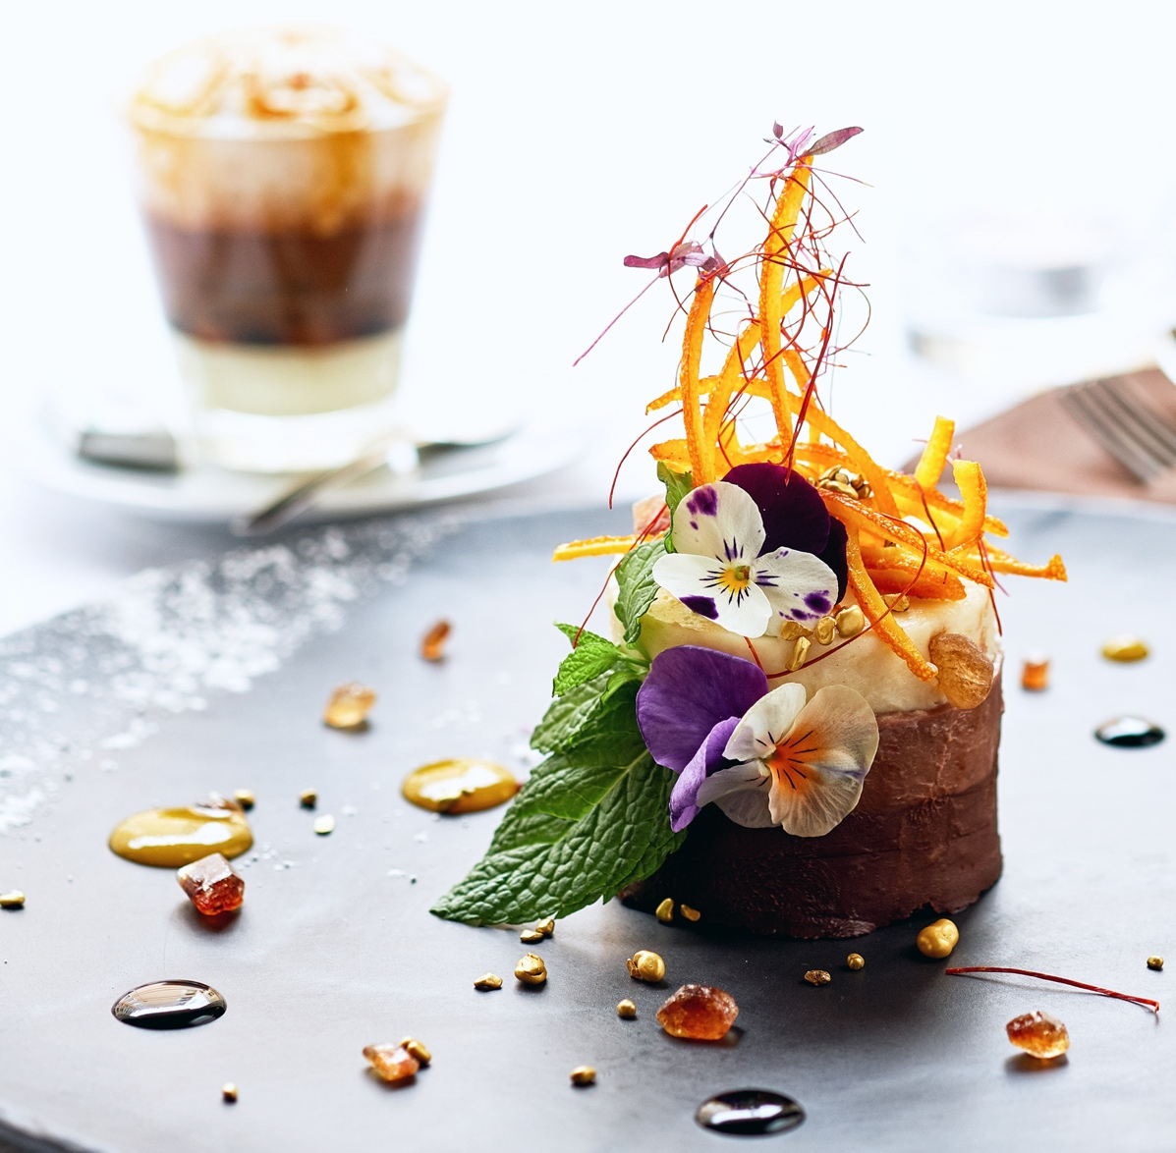
UNDERSTANDING COMPOSITION AND THE RULE OF THIRDS
The rule of thirds describes a basic compositional structure of a photograph. Taking any image, you can split it into nine segments by using two vertical and two horizontal lines.​
​
When you’re photographing food, use the rule of thirds to provide an area for the subject in the image. In the photo below, the granola mix and fruit is featured in two-thirds of the area horizontally and vertically.
There are “points of interest” in the areas where two lines intersect. ​
The rule indicates that you should place key elements of your scene at one or more of these areas in a photo.​
​
Your smartphone’s camera may have a compositional grid overlay as a settings feature to make positioning a subject easier.​
​
If you’re new to the rule of thirds, shoot a wider image, then crop later to achieve the composition you’re trying to create.​​

Slide 4
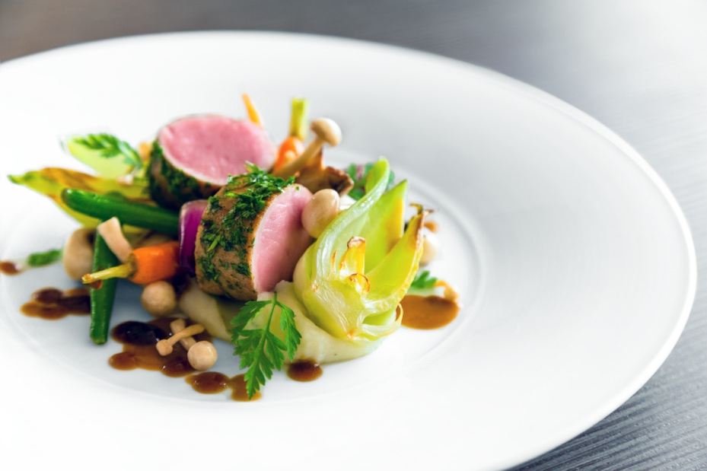
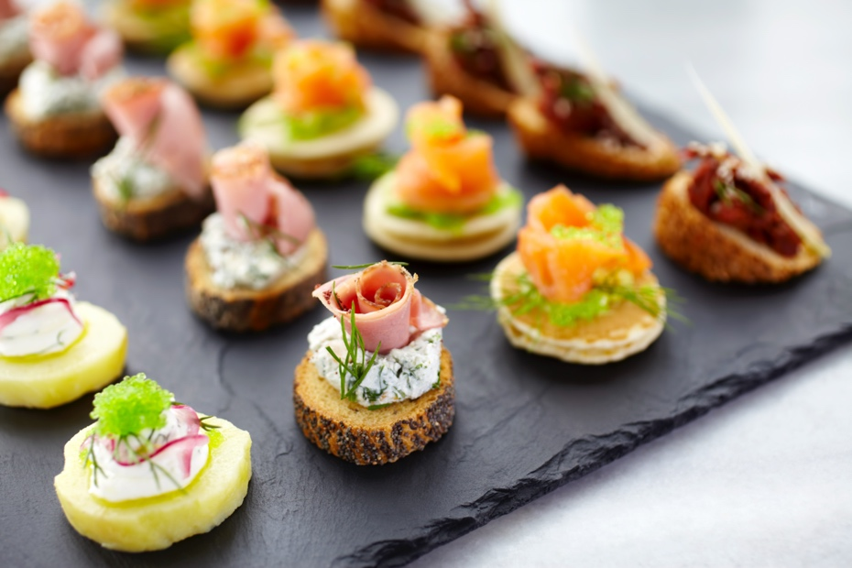
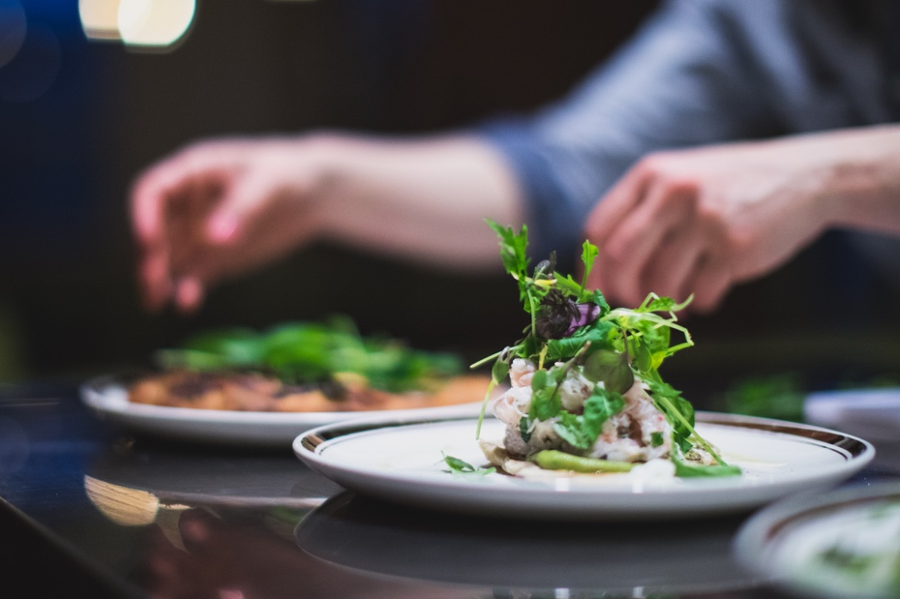
QUALITY AND FOCUS
For print-quality reproduction, photos should be high resolution with 300 dpi.
A big part of quality photography is also getting the focus right. Missing the focus even slightly can turn a potentially great photo into a bad one.​
​
While smartphones take great photos, their auto-focus system doesn’t always create the look you’re aiming for. If you can manually choose your area of focus, apply the rule of thirds when shooting your images.

Slide 5
PHOTOGRAPHING PEOPLE
When photographing people for publications, consider limiting the frame to the face and chest area to better capture the subject’s personality. Full-body photography works great when you’re trying to capture the subject’s presence in a setting. Sodexo chefs should be wearing a Sodexo-approved uniform if preparing food. Whether you choose a closeup or a full-body shot, the eyes should always be in focus in your photograph.
Portrait photography is very effective with a minimalist or plain background. If a background will be included, lessen distracting elements by positioning your subject in front of objects or blurring the background. Always be sure kitchen conditions are clean and safe – additional tips are found on the last slide.

Slide 6
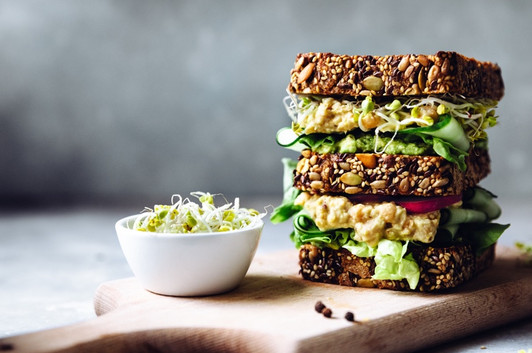
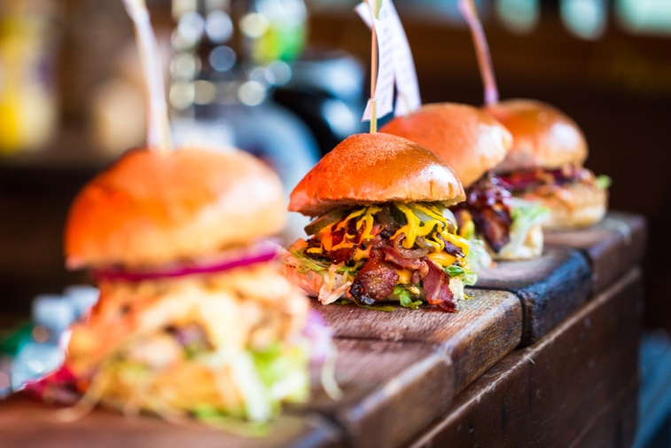
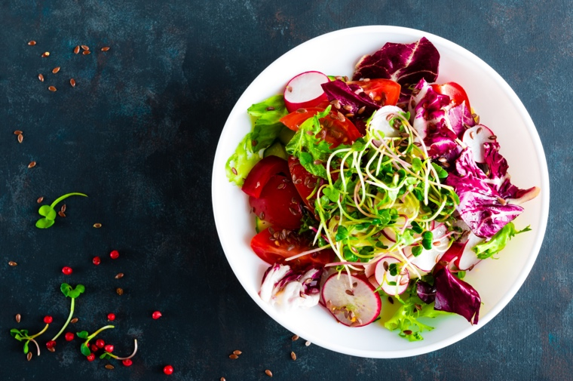
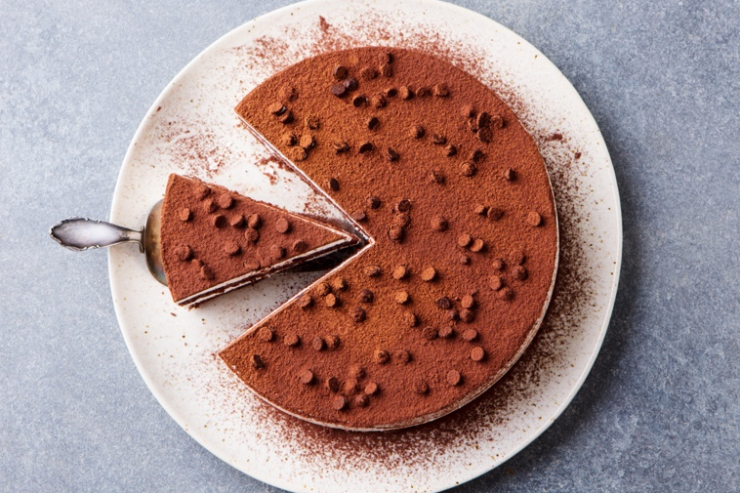
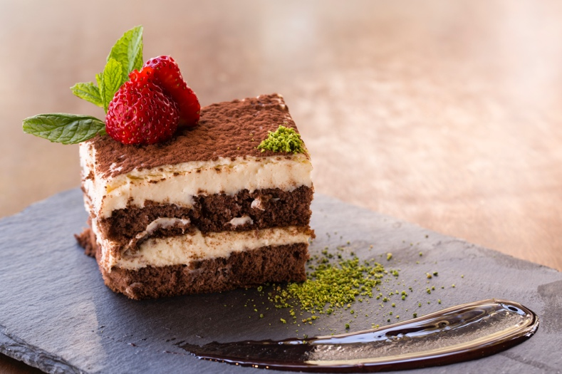
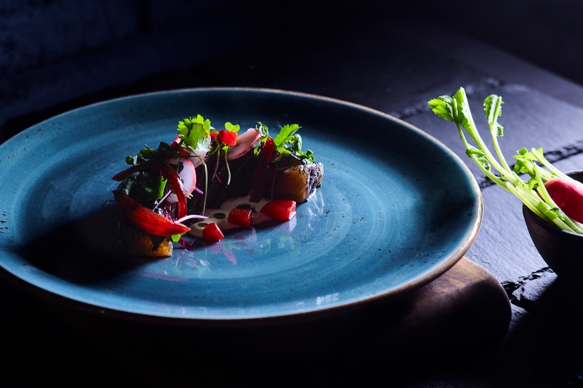
PHOTOGRAPHING FOOD
When photographing food, lighting is the most important element for showcasing amazing dishes and authentic colors. In most kitchens, natural light isn’t available so you’ll need to find creative ways to light your food photography without creating harsh shadows or flat tones.
For individual food shots, get in close to showcase the ingredients, textures and colors. For wider shots, it’s important to create a pleasing composition of visual elements and minimize clutter. Be sure to experiment with different angles for different foods: Sandwiches photograph best with a front view, bowls and pizzas from an overhead view and composed plates at a 45-degree angle.

Slide 7
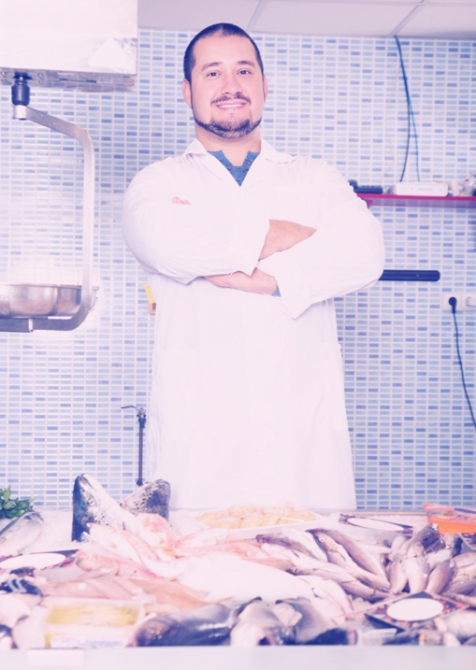
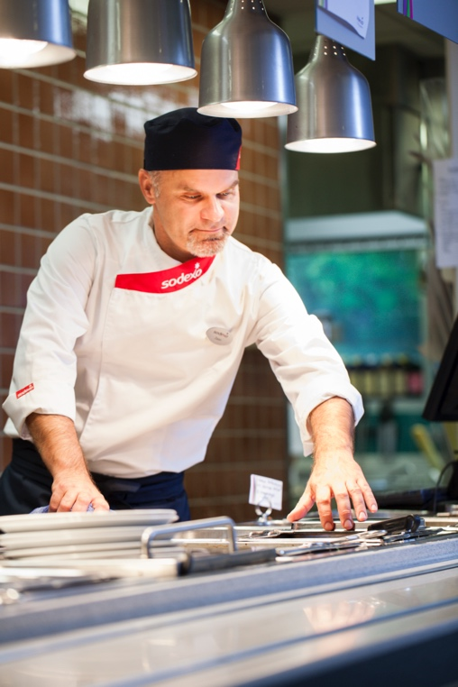
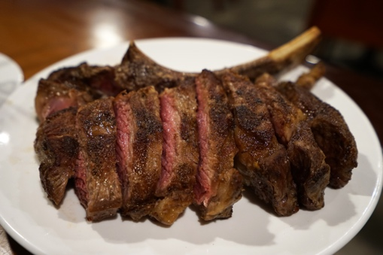
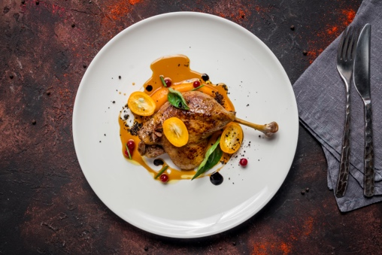
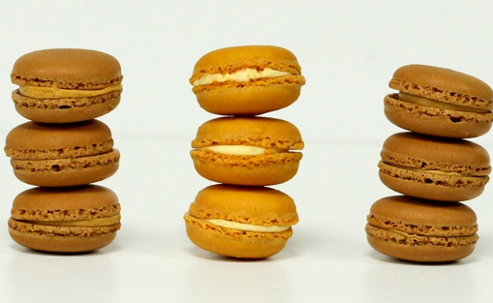
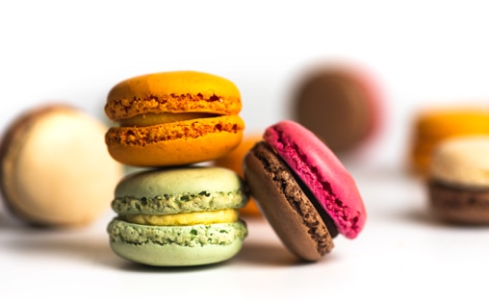
SET UP FOR SUCCESS
Photography is fun and creative—and with just a few tips, you can create engaging images.
Set up action shots to convey a story and put the viewer right in the scene. While the photo on the left includes interesting details of the chef’s kitchen and menu, the “movement” of the chef on the right helps you envision his expertise and flair for the craft.
Great food photography features engaging backgrounds, colors and vantage points. Spice up images with a mix of ingredients, visual textures and views.
Proportion and order can certainly be appealing in photos, but relaxed styling, varied depth of field and color interest can bring more excitement to a subject.

Slide 8
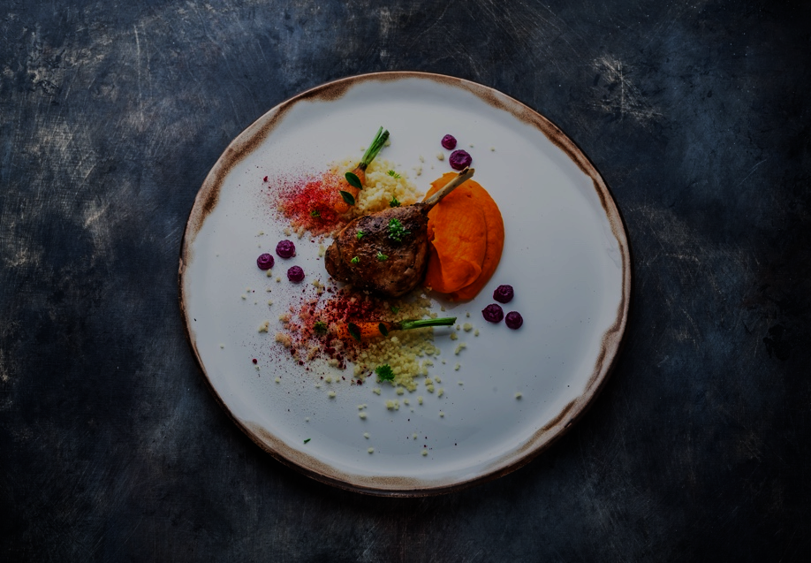
BASIC RETOUCHING PROCESS
Every photo benefits from retouching. There are many retouching apps and programs that you can use, including the best-known Adobe Lightroom or Photoshop. Snapseed is a free photo-editing app from Google, is available for Android and iOS mobile devices and features a wide range of filters. Photo-editing software will take your photos from good to great!
From this…
…to this

Slide 9
SODEXO FOOD SAFETY TIPS
Employees must wear the Sodexo uniform and wear an appropriate hair covering where open food is handled. Waitresses and waiters are required to secure hair back neatly. Aprons, oven cloths and gloves, etc. must be in a clean condition.
Use the correct knife and color-coded chopping boards for food preparation.
Raw foods e.g. unwashed vegetables, raw meat, and shell eggs must be stored and handled separately to ready-to-eat foods.
Display items in service areas must not present a food safety risk.
Soil potted plants are not permitted in catering areas.
Work areas must be kept free of clutter.
Chemicals must be stored separately from food storage and preparation areas and therefore should not be visible.
Follow country allergen management and jewelry policies. It is not recommended that food handlers wear watches, as in many regions these are not permitted.
If you require further support or guidance please contact your Regional / Country HSE team.

